Slide 1
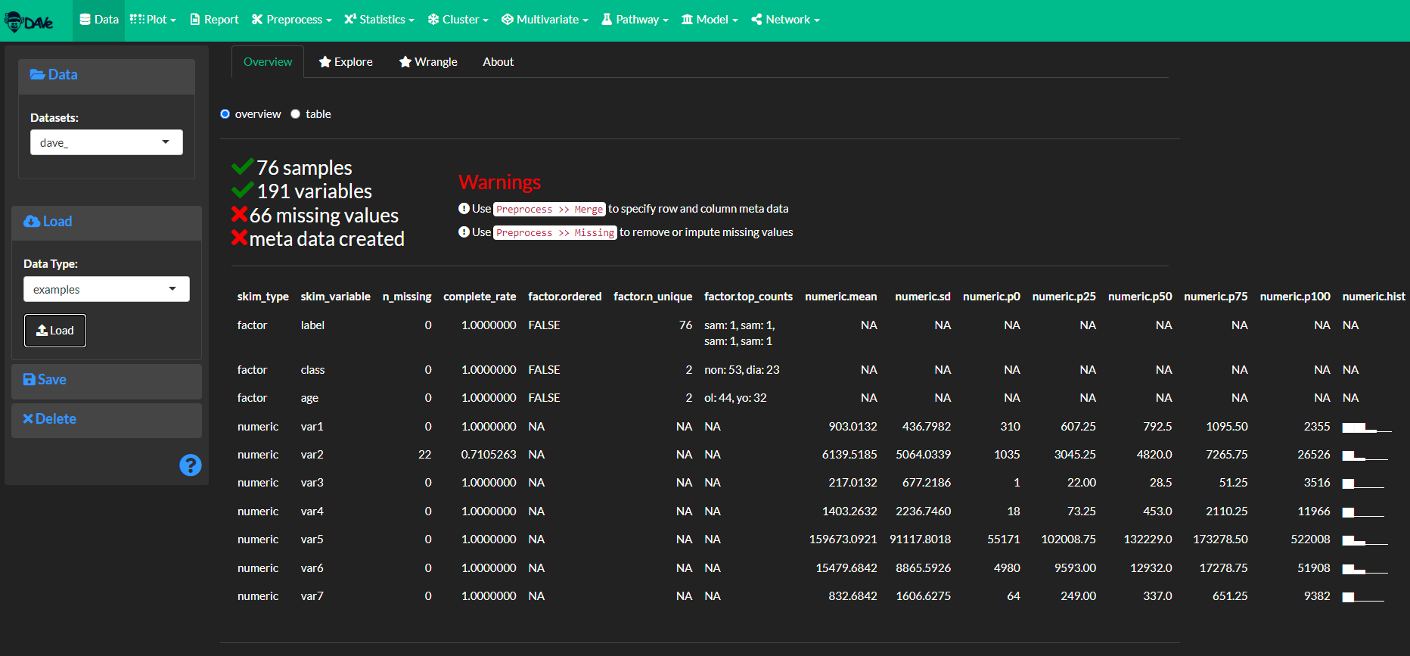
# Loading example data
##### For this example we will use the data set from the following manuscript: [Systemic alterations in the metabolome of diabetic NOD mice delineate increased oxidative stress accompanied by reduced inflammation and hypertriglyceremia](https://pubmed.ncbi.nlm.nih.gov/25852003/).

Slide 2
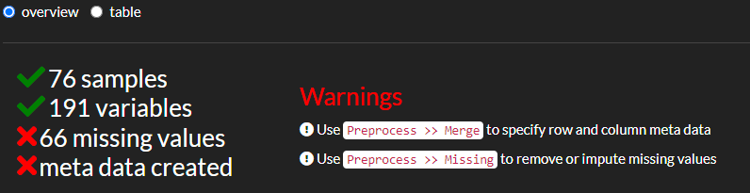
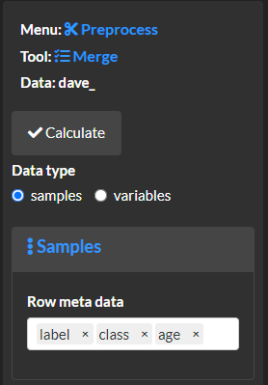
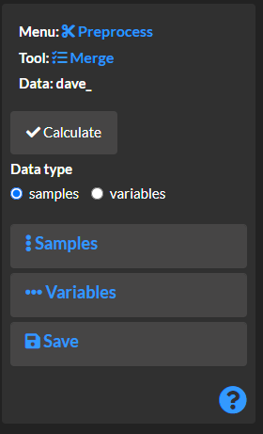
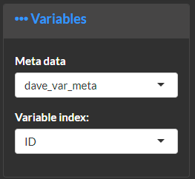
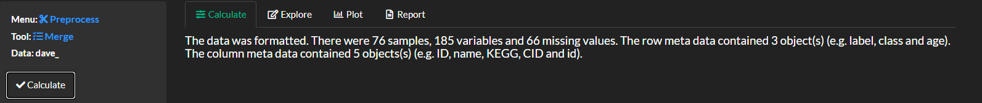
# Prepare the data for analysis
##### Use the [preprocess >> merge]{.txbox_green} module to format the data set and merge with the variable meta data. Select the blue question mark icon at the bottom right to get detailed instructions.
##### Add non-numeric variables to the row meta data.
##### Merge the data index with meta data describing the numeric variables (e.g. KEGG and CID identifiers).
##### Select calculate and overview the results.

Slide 3
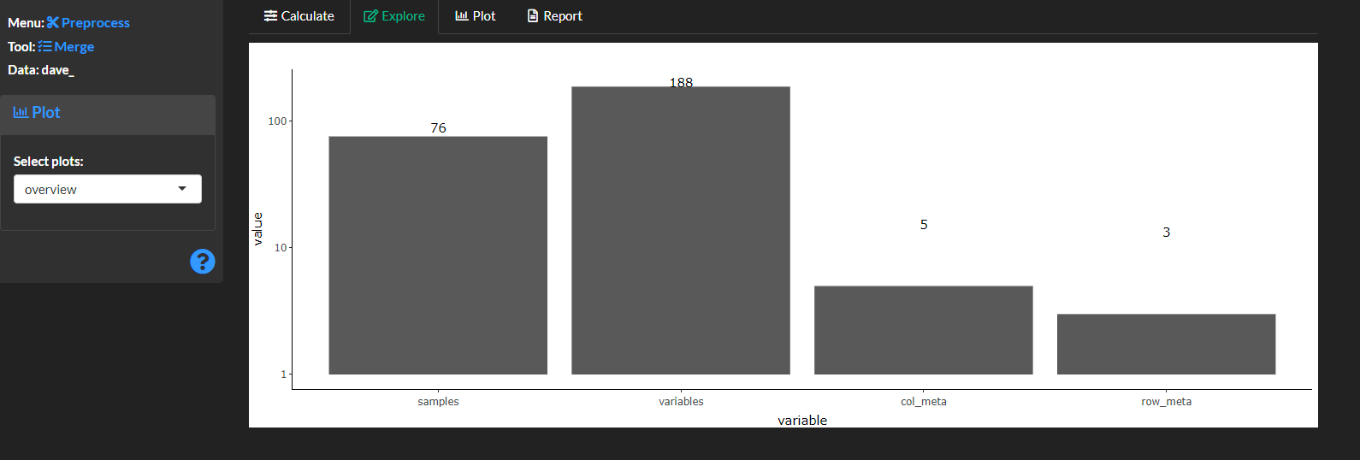
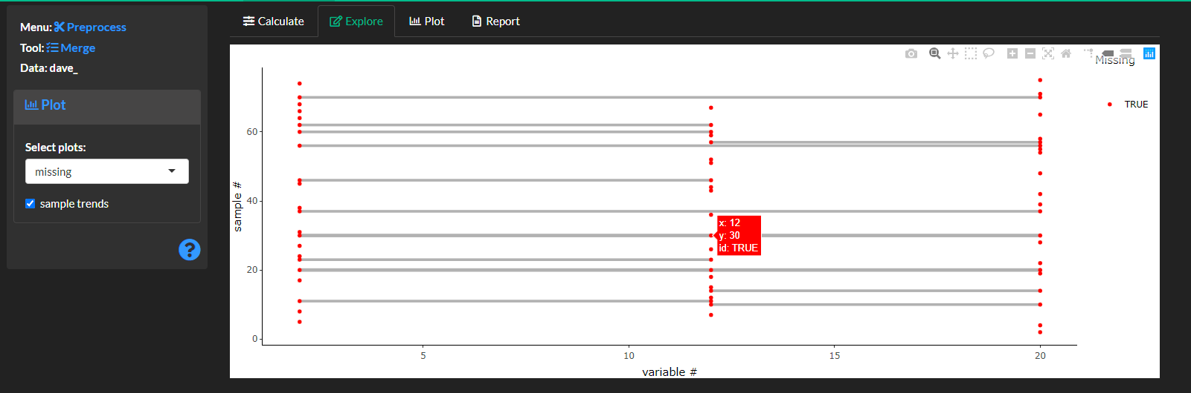
##### Explore the results.
##### View the dimensions for the created data assets.
##### Over view missing values for each sample (row) and variable. Connected lines show missing values for the same sample for multiple variables.

Slide 4
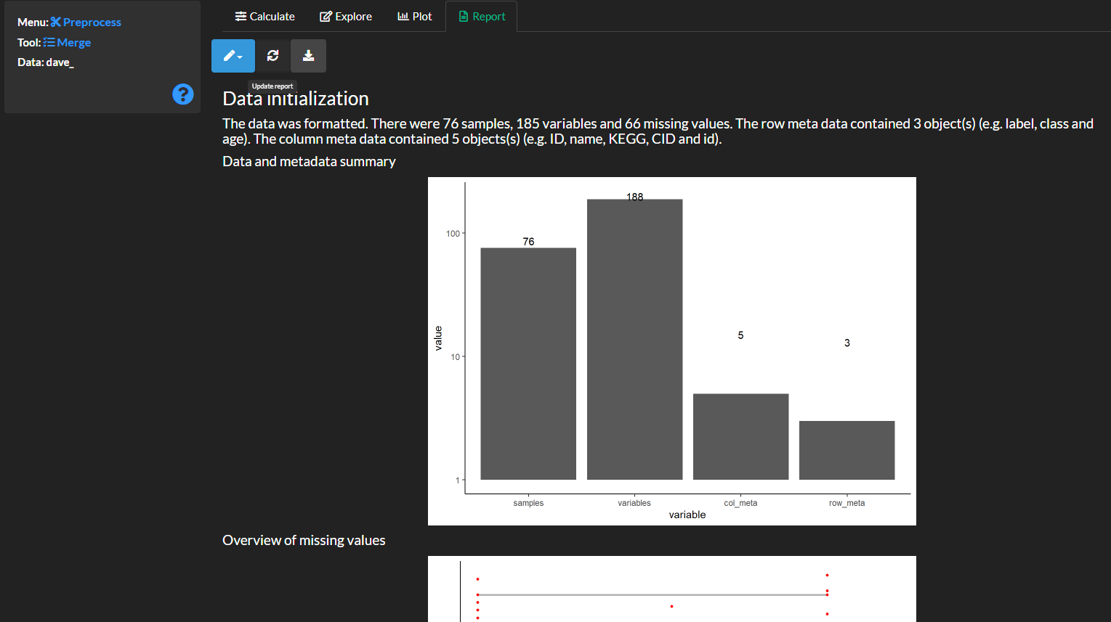
##### Create a report capturing the methods results and figures.

Slide 5
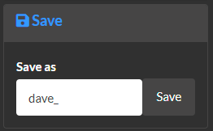
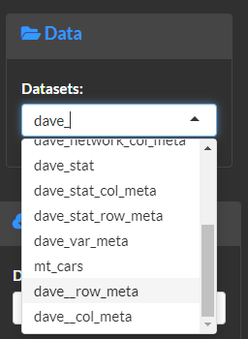
##### Save the results for later analyses. Note the created sample and variable meta data can be viewed in the [data]{.txbox_green} menu as `dave__row_meta` and `dave__col_meta`, respectively.

Slide 6
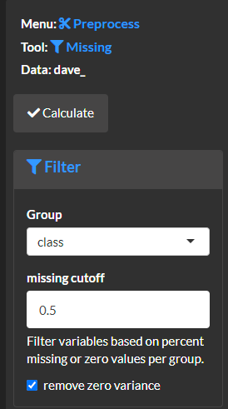
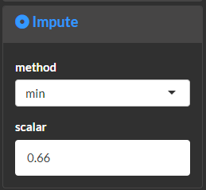
# Remove missing values
##### Use the [preprocess >> missing]{.txbox_green} module to remove and/or impute missing values. Note this is an important step to make sure down stream analyses are compatible.
##### Use the [filter]{.txbox_blue} menu to drop variables which have > greater than the `missing cutoff` percent missing values for a factor of interest, `group`. For examples the example selection will remove any variables which have more than 50% missing values for any levels of the `class` factor.
##### Use the [impute] {.txbox_blue} menu to impute any remaining missing values. For example, the example options will impute the remaining missing values as 2/3 the minimum for of each variable. This is a reasonable assumption if values are missing because they are below the limits of detection.

Slide 7
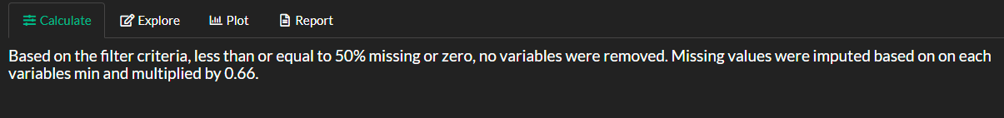
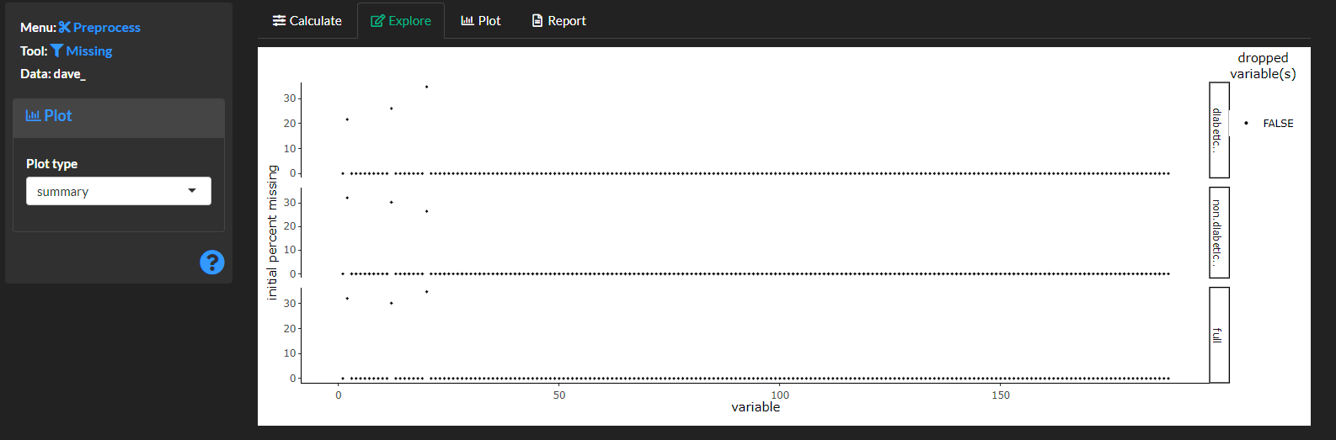
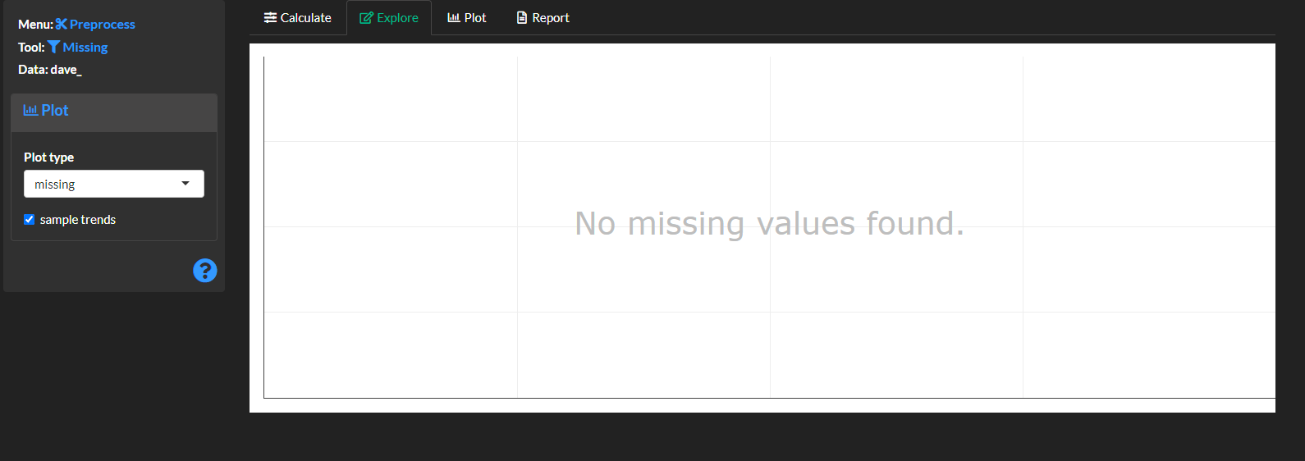
##### View the imputation methods and results.
##### Explore the missing values and any removed variables. There should be no missing values if the imputation was successful.

Slide 8
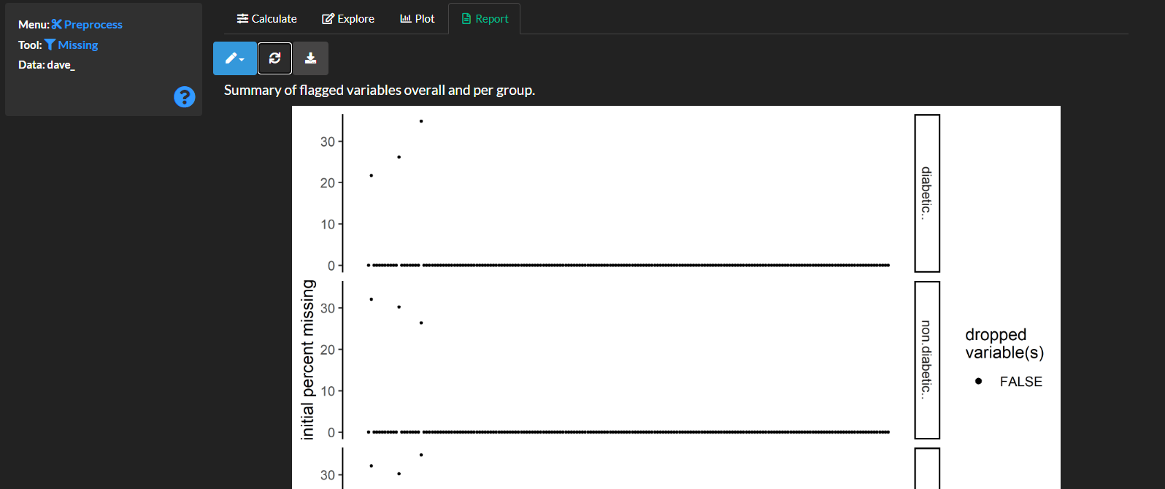
##### Create a report capturing the methods results and figures.

Slide 9
##### Save the results for later analyses.

Slide 10
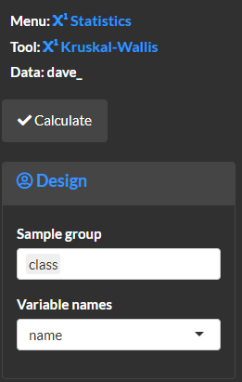
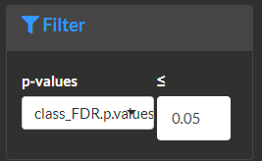
# Identify significant differences between groups.
##### Use the [statistics >> two-class]{.txbox_green} to carry out a non-parametric test to identify significant difference for the `class` factor which corresponds to diabetic or non-diabetic samples.
##### Use the [filter]{.txbox_blue} menu to optionally only keep significant results. The example shows how to select comparison which display false discovery rate adjusted p-values less than or equal to 0.05.

Slide 11
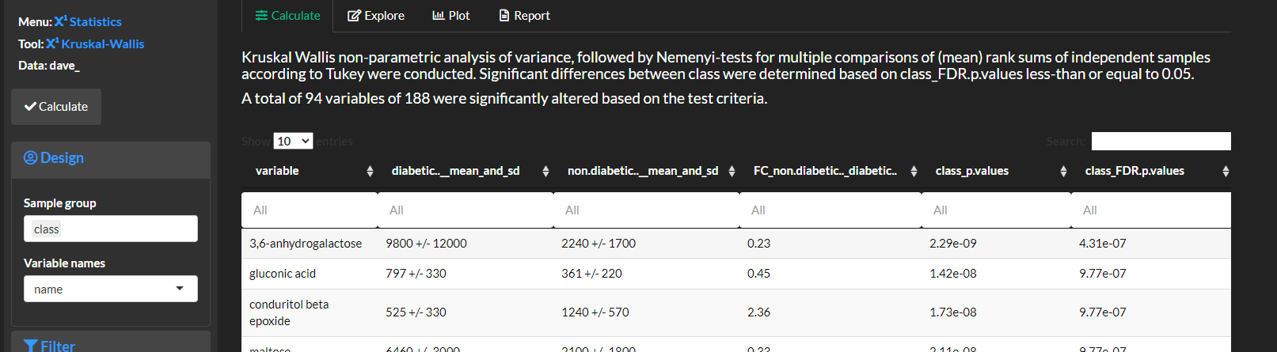
##### Select `calculate` and view the statistical analysis methods and results.

Slide 12
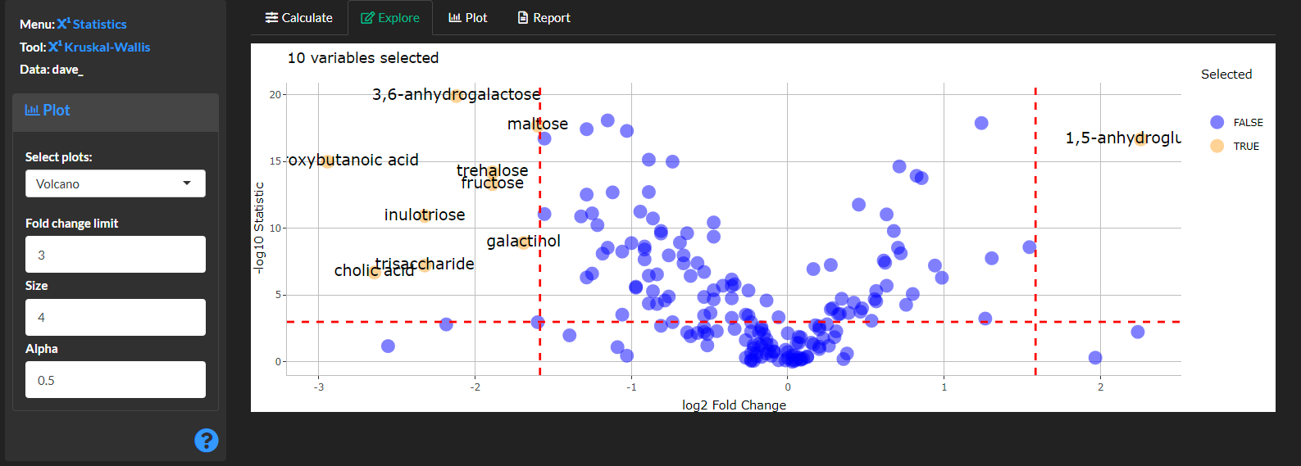
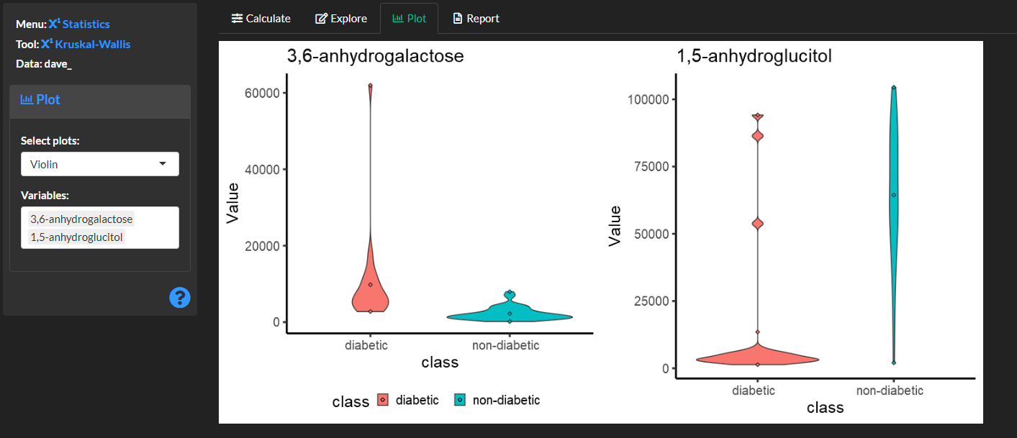
# Explore the results
##### Create a volcano plot to display significantly altered variables p-values vs. the fold change in `class` means.
##### Optionally create violin plots to view the class distributions for select variables. Note only the [plot]{.txbox_green} option allows plotting of multiple variables which will be shown in the report.

Slide 13
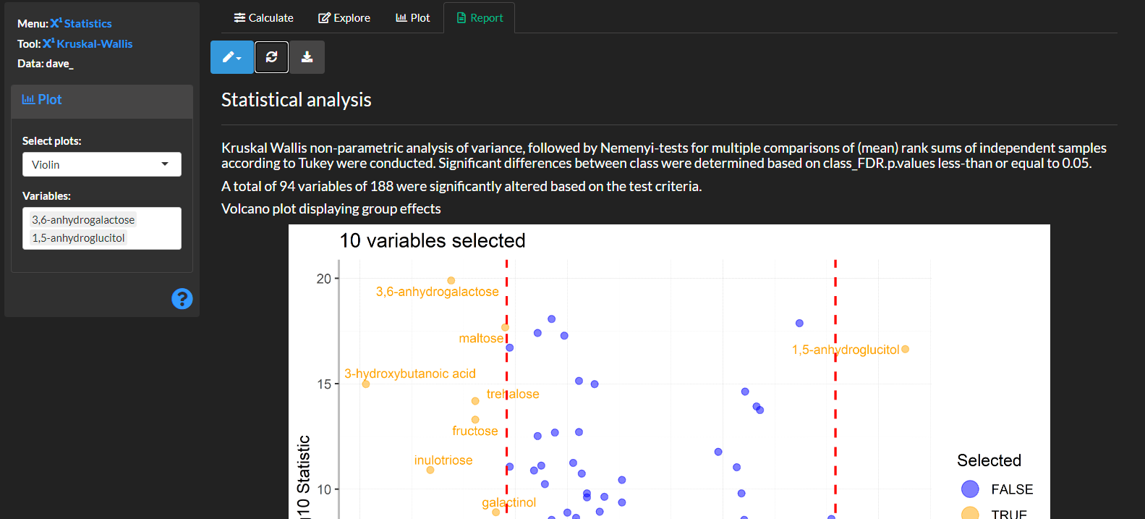
##### Create a report capturing the methods results and figures.

Slide 14
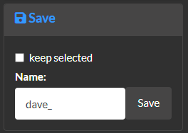
##### Save the results for later analyses. Optionally remove any variables not meeting the significance cutoff from the dataset (`keep selected`).

Slide 15
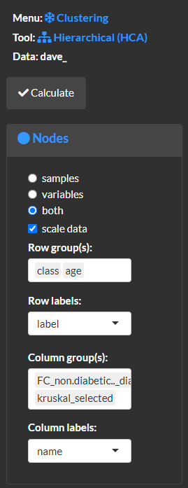
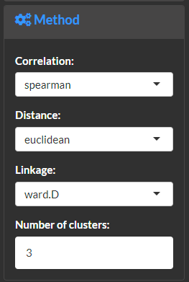
# Use the [cluster >> heirarchical]{.txbox_green} module to overview an unsupervised grouping of the data.
##### Specify the [node]{.txbox_blue} properties and what dimensions of the data (samples (rows), variables (columns) or both) to cluster. For example, the selected options will cluster both rows and columns, scale the data based on subtraction of column means and division of column standard deviations, annotate the heat map to show `class` and `age` for samples and fold-change of means for `class` and significantly altered variables.
##### Use the [method]{.txbox_blue} menu to specify if the raw data or correlations should be clustered, the distance and agglomeration method and how many groups should be extracted.

Slide 16
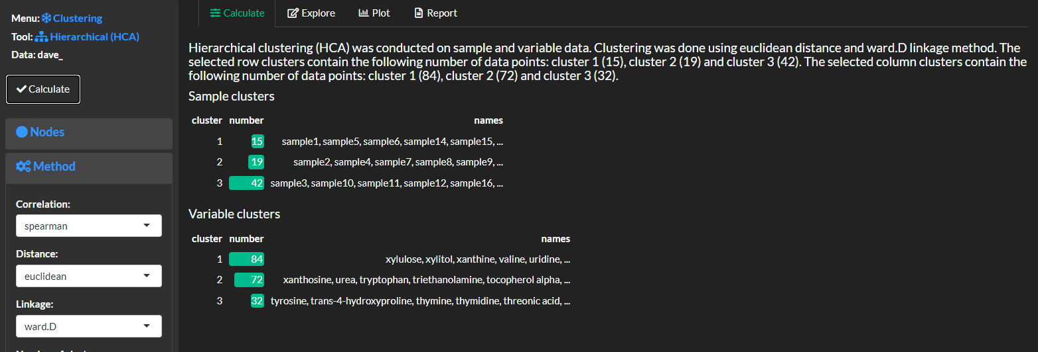
##### Select `calculate` and view the clustering methods and results. For example, the following shows how many samples and variables were selected for each cluster.

Slide 17
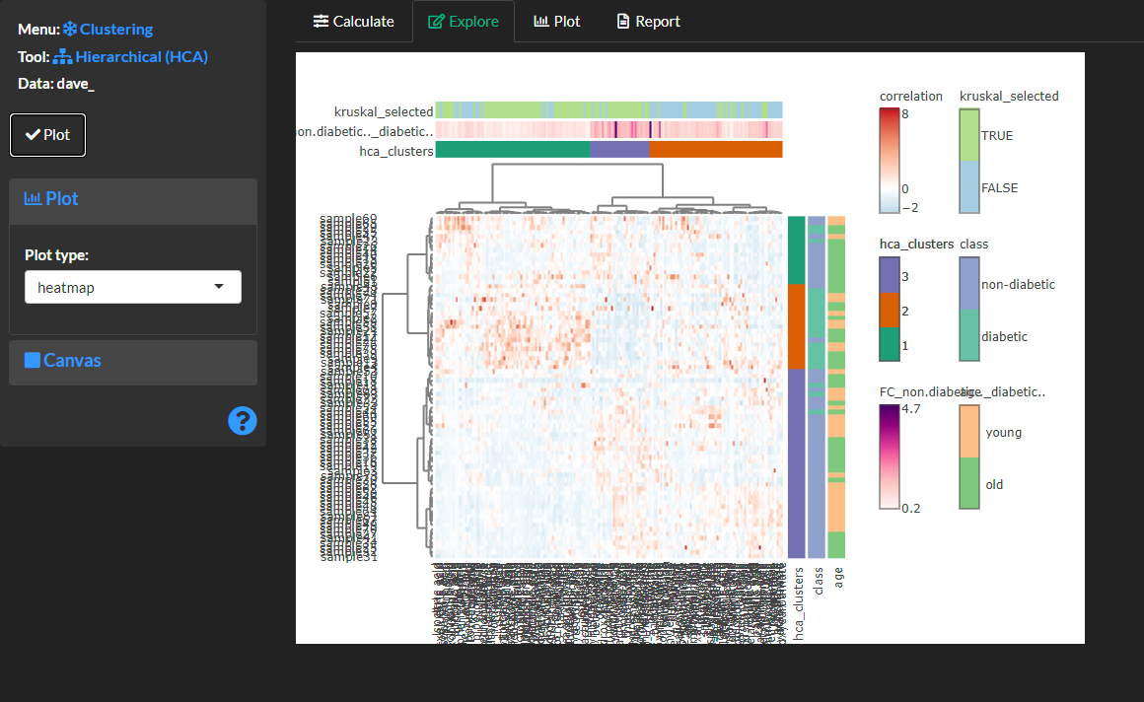
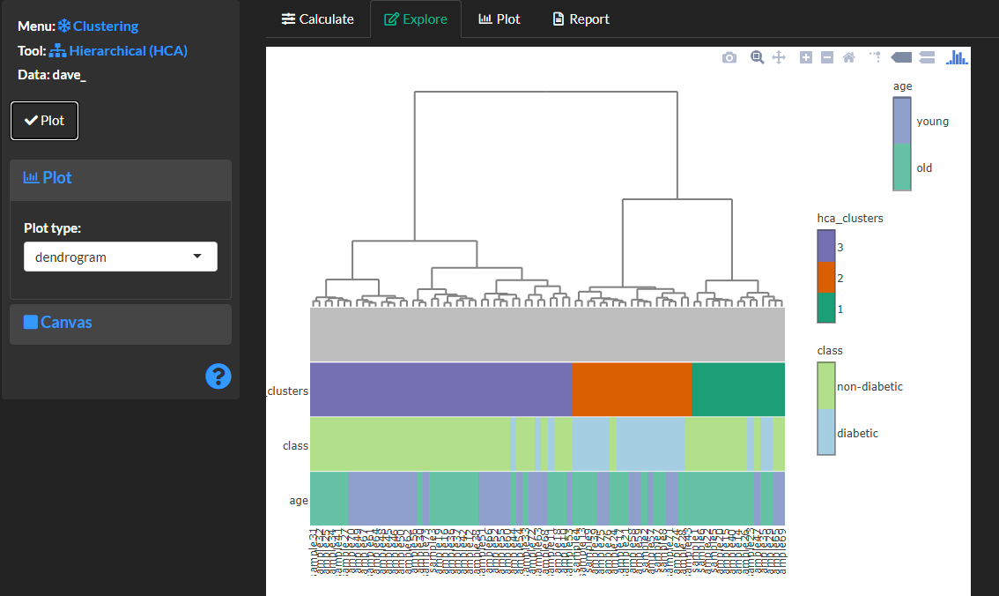
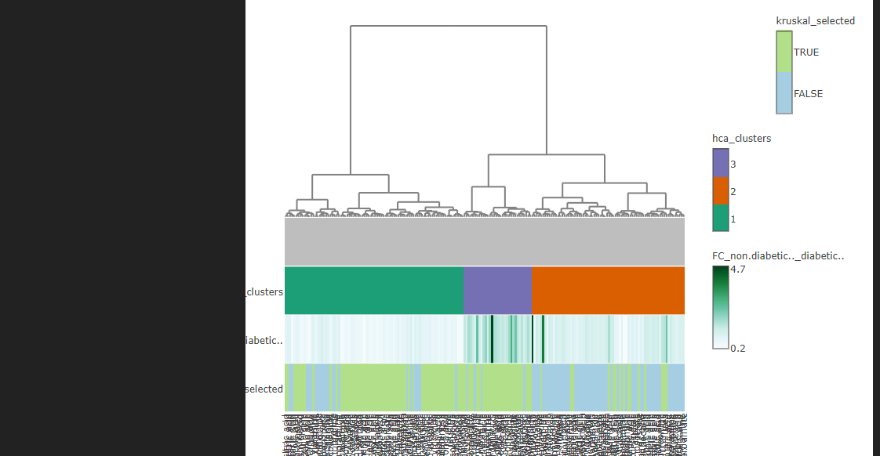
# Explore the results
##### Create a `heatmap` or `dendrogram` to view the clustering results. Note, dendro grams are plotted separately for samples and/or columns.

Slide 18
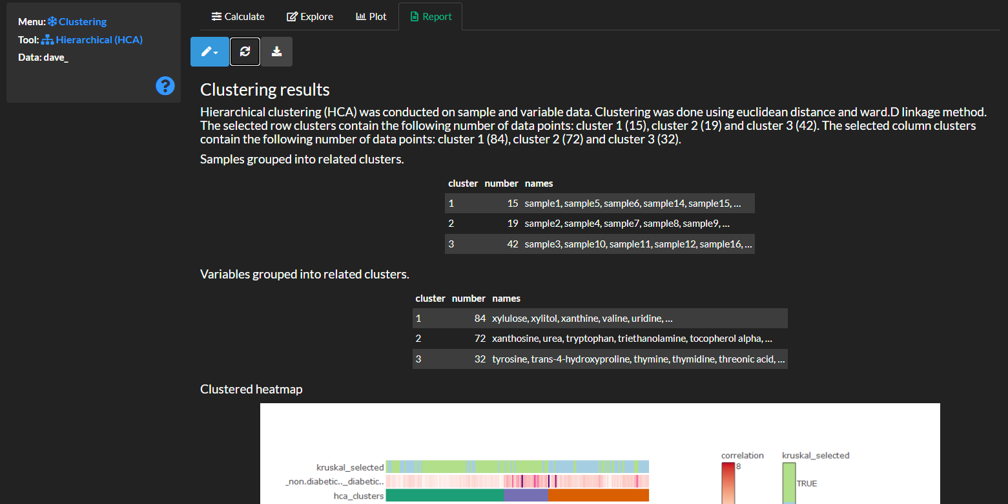
##### Create a report capturing the methods results and figures. Note, before creating the report use the [plot]{.txbox_green} menu to render the plots which were explored.

Slide 19
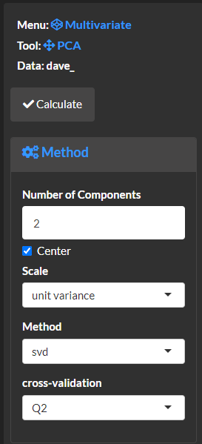
# Use the [Multivariate >> PCA]{.txbox_green} module to overview the major modes of variance in the data.
##### Specify the [method]{.txbox_blue} selecting the number of components (components summarize trends for all variables), the scaling method to transform columns, decomposition `method` to calculate PCA and the `cross-validation` method to evaluate the models ability to reconstruct the original data.

Slide 20
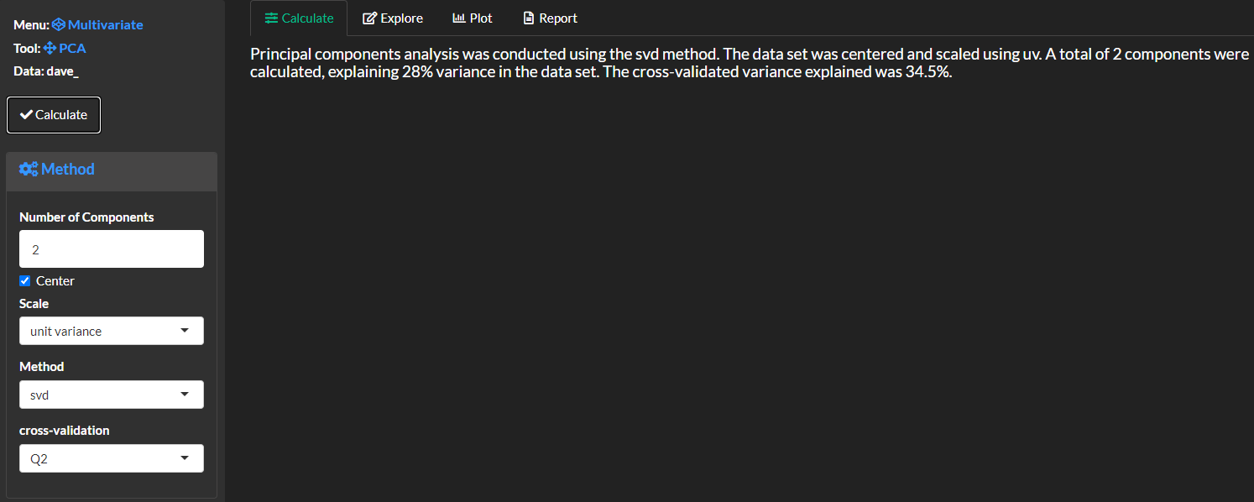
##### Select `calculate` and view the analysis methods and results.

Slide 21
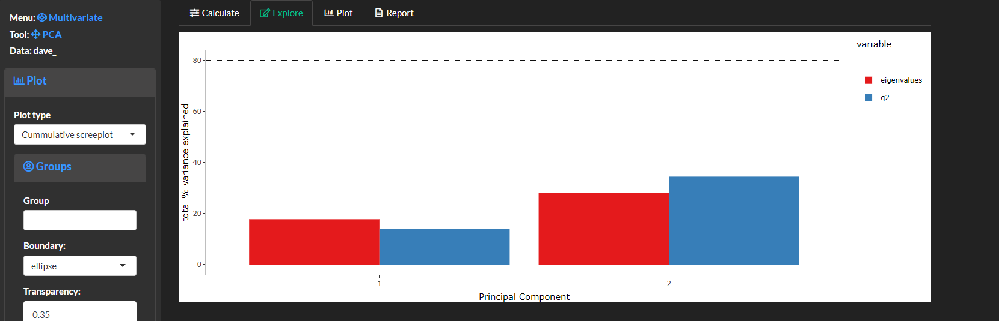
# Explore the results
##### Create a `cumulative screeplot` to view the cumulative (sum) variance explained for the selected components. Note the first two principal components, principal plane, explain the major modes of variance in the data. However, to better reconstruct the full data enough components to reproduce at least 80% of of the variance (as denoted by the eigenvalues or cross-validated q2).

Slide 22
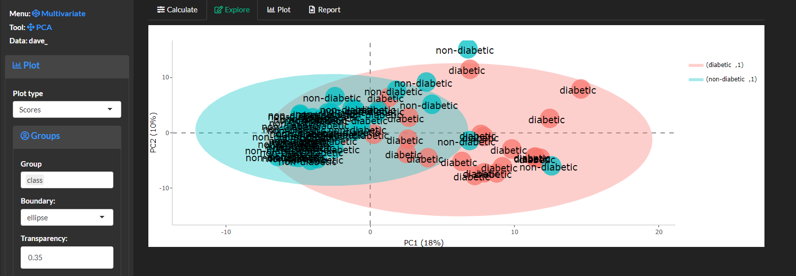
##### Create a plot of sample (row) `scores` to view the cumulative (sum) variance explained for the selected components. Note the first two principal components, principal plane, explain the major modes of variance in the data. However, to better reconstruct the full data enough components to reproduce at least 80% of of the variance (as denoted by the eigenvalues or cross-validated q2).

Slide 23
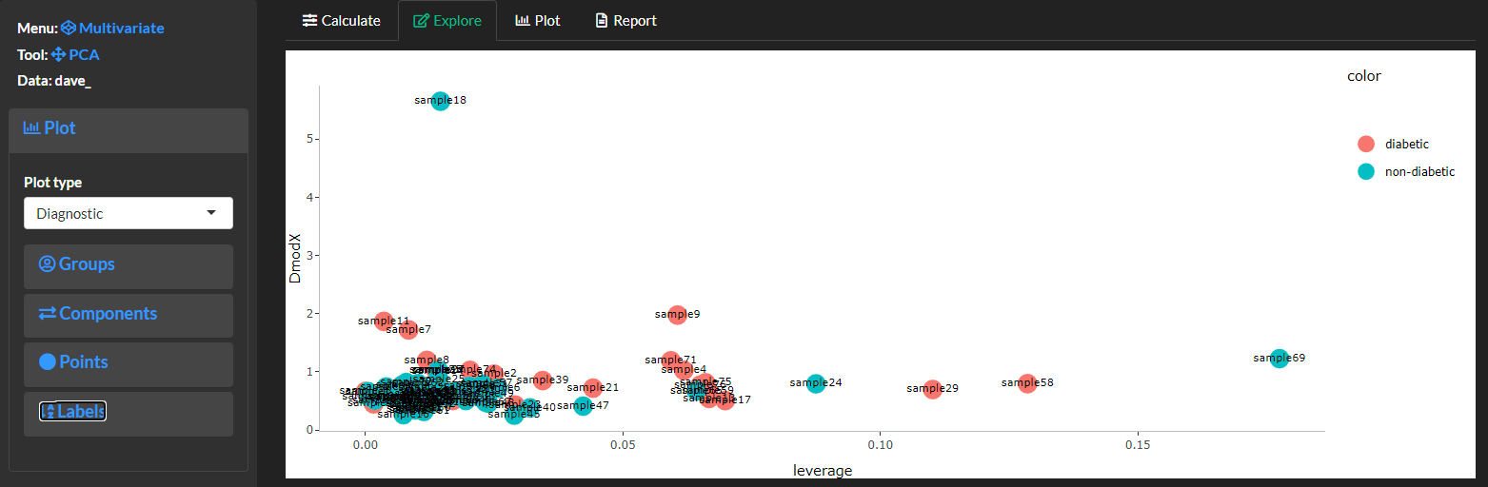
##### Create a `diagnostic` plot to overview extreme (leverage) and intermediate (DmodX) sample outliers. Leverage corresponds to sample outliers in the principal plane and DmodX samples which are far in the projection (orthogonal) to the principal plane. Any samples with high leverage and DmodX may need to be removed to improve the model fit of projection pursuits like PCA.

Slide 24
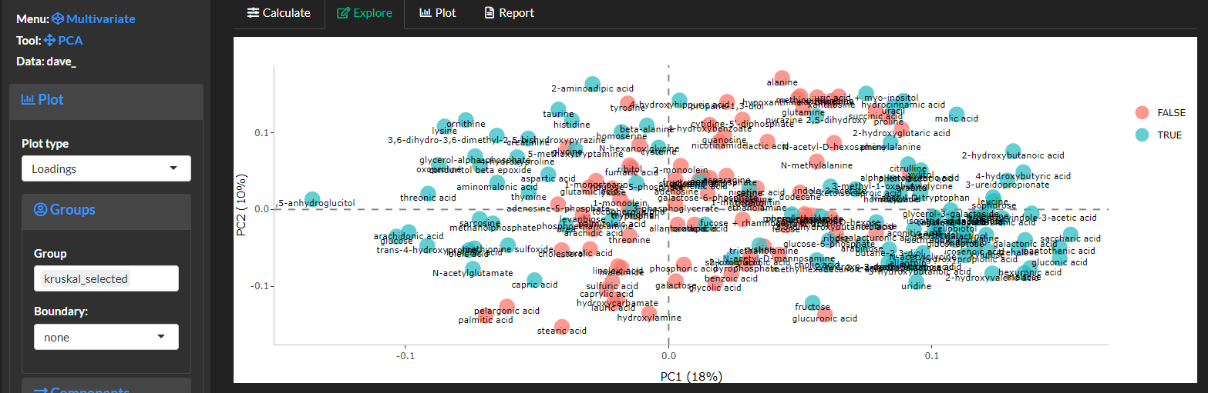
##### Create a `loadings` plot to view variable contributions to samples `scores`. Use the [labels]{.txbox_blue} to specify variable names and text size. Variables with large loadings on the x-axis or y-axis have the largest contribution to defining sample scores in the x-axis and y-axis, respectively. For example the following plot suggests that as sample scores move left on the x-axis the contain larger amounts of 1,5-anhydroglucitol. Variable loadings can be colored base on variable meta data. For example, we can view which variables displayed significant differences for `class` based on the statistical test (shown in green).

Slide 25
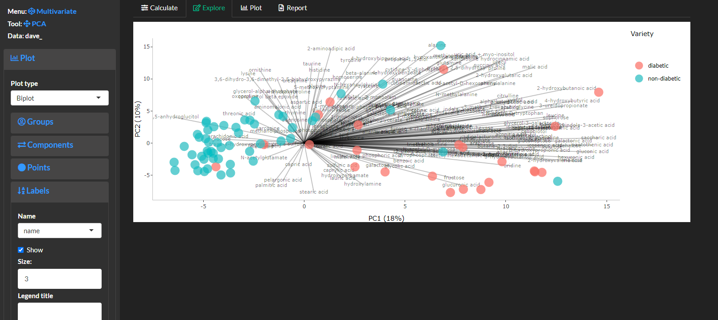
##### Create a `biplot` which overlays samples `scores` and variable `loadings`. This plot can be used to get an overview of the variable abundance among samples as encoded by the PCA. For examples, diabetic samples generally have high amounts of 1,5,-anhydroglucitol (the reverse can be said of non-diabetic samples) and diabetic samples have high amounts of 2-hydroxybutanoic acid (the reverse can be said of diabetic samples).

Slide 26
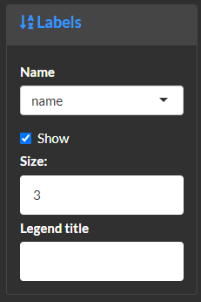
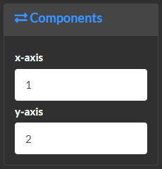
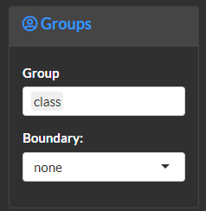
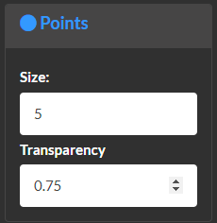
##### Customize plots by specifying which components to view. Which groups to base point colors on and their border. As well as point size and transparency. The labels menu can be used to modify point labels text and size and the legend title.

Slide 27
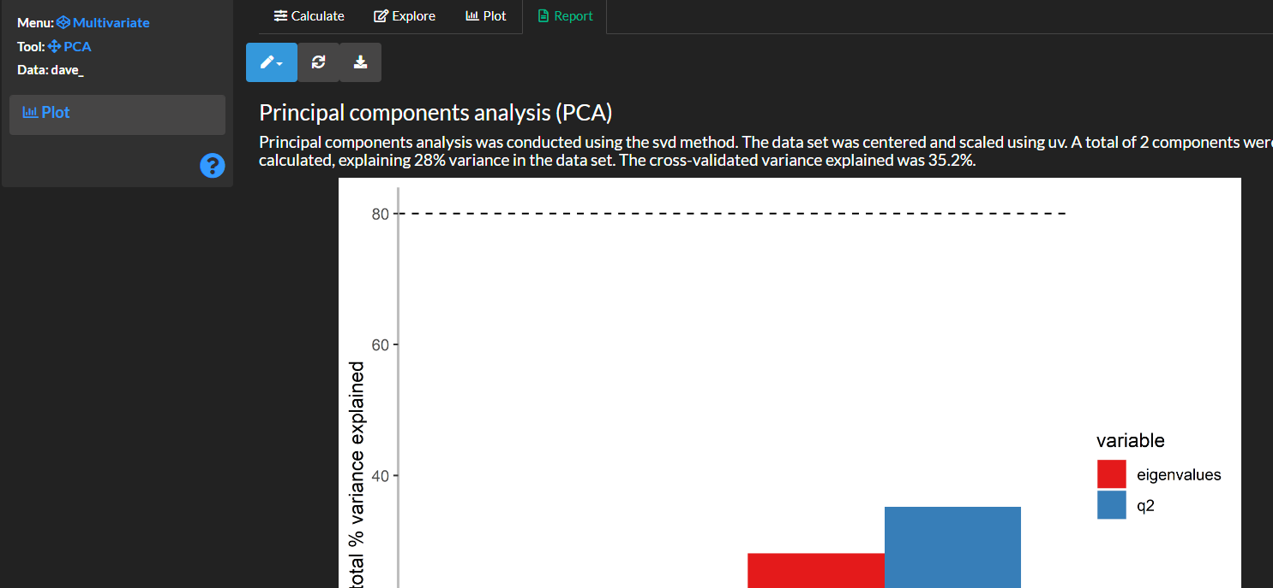

Slide 28
##### Save the results for later analyses. This will save the principal component `scores’, sample `leverage` and `DmodX`.

Slide 29
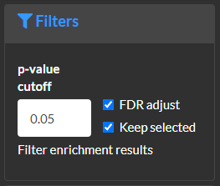
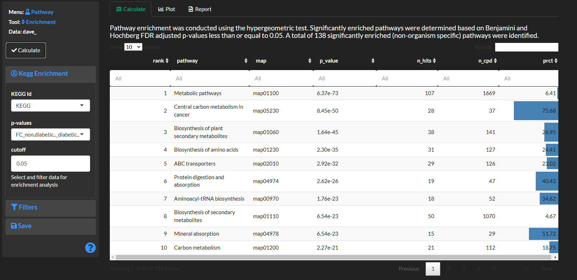

Slide 30
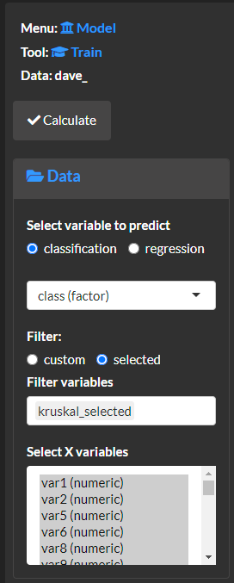
# Use the [Model >> model]{.txbox_green} module to create a machine learning-based predictive model. Models are useful for identifying how well the data can classify groups(classification) or predict continuous variables (regression). Model variable importance and coefficient weights are useful for determining the contribution of each variable to the model performance.
##### Specify the variable to be predicted by using the [data]{.txbox_blue} menu and selecting a `regression` (continuous numeric variable) or classification (factor or discreet). Next, select the variables to build the model and optionally filter options based on previous analyses. The following example shows how to select only significant variables based on statistical analysis.
#####

Slide 31
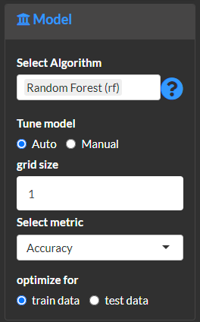
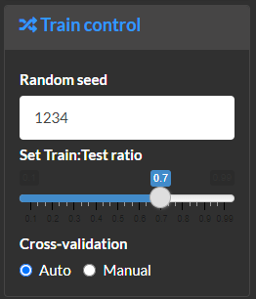
##### Use the [model]{.txbox_blue} menu to specify the modeling algorithm. Use `tune model` to specify how to tune model hyperparameters, where auto will create a `grid` of size `grid size` of all possible hyperparameter options for the selected algorithm. Select the `metric` to use to evaluate the model quality and select optimal hyperparameters. Use the optimize for option to show relevant information for the training or test data (recommended). Note, you can select multiple model algorithms to calculate and select optimal models from.
##### Use the [train control]{.txbox_blue} menu to specify the proportion of the data to use to train and test the model. Optionally select to manually define the model cross-validation options used during model training and scoring.

Slide 32
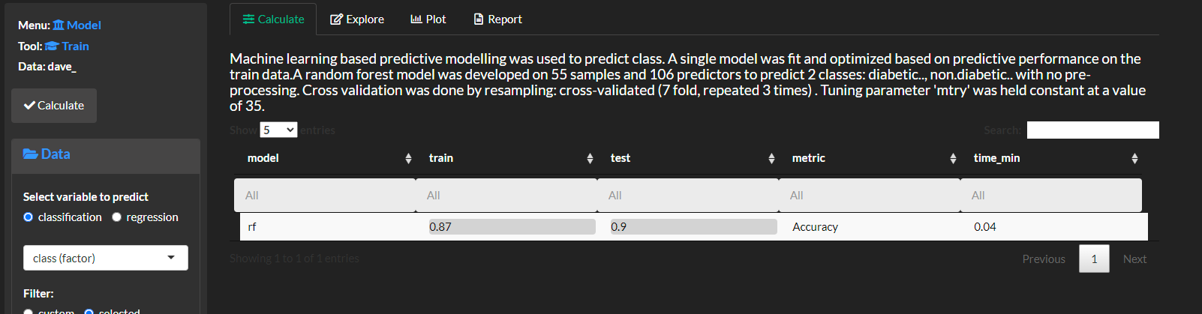
##### Select `calculate` to view the model results.

Slide 33
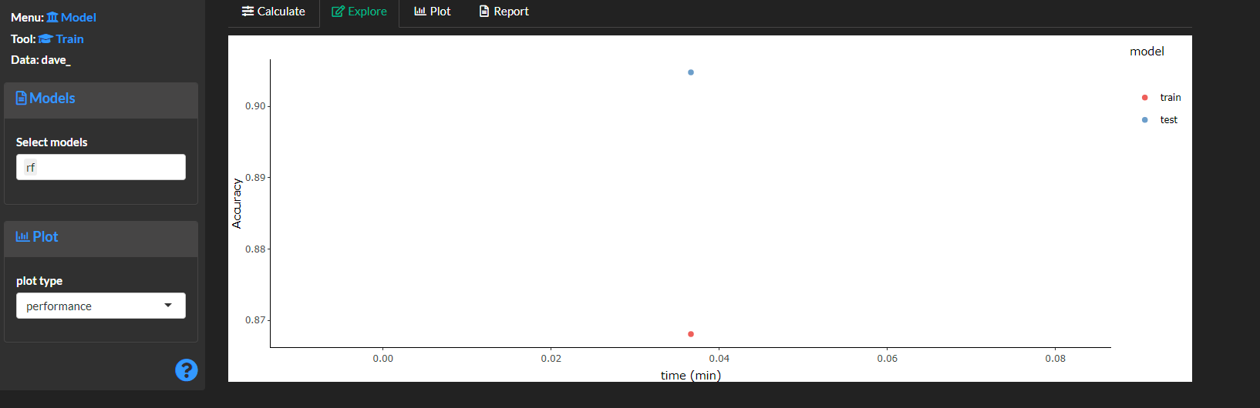

# Use the [explore]{.txtbox_green} menu to view the modeling results.
##### The `performance` plot to compare model performance and training time.
##### The `model` plot to shows model scores for a variety of metrics.

Slide 34



##### The `importance` ranks all features based on their contribution to the model performance.
##### The `model` plot to shows model scores for a variety of metrics.
##### The `confusion` (matrix) plot shows predicted vs. actual sample classifications. Use show `show metric` to plot counts or percent or correctly and incorrectly classified samples.
##### The `classification` plot is used to create a precision vs. recall or area under the receiver and operator curve (ROC).

Slide 35

##### Save the results for later analyses. Use `cache models` to save specific model results. Unselect the `cache models` option if you want to create predictive models for different objectives for the same data set.

Slide 36



# Use the [Model >> select]{.txbox_green} module to carry out feature selection to identify the most predictive variables to predict the variable of interest. Note use the [Model >> model]{.txbox_green} menu to first create model and initialize the training and test data.
##### Specify the variable to be predicted by using the [data]{.txbox_blue} menu and selecting a `regression` (continuous numeric variable) or classification (factor or discreet). Next, select the variables to select from.
##### Use the [optimize]{.txbox_blue} menu to select the algoritjm to rank variable’s predictive power. The `initial subset` defines the minimum and maximum of optimal variables to pick. The `metric` specifies how to score each model for the variable selection procedure.
##### The [validate]{.txbox_blue} menu can be used to specified the model cross-validation which is used to calculate the `metric` for each subset of variables.

Slide 37

##### Select `calculate` and view feature selection results.

Slide 38


# Use the [explore]{.txtbox_green} menu to view the feature selection results.
##### The `overall` plot shows the model performance metric selected in `optimize` for each subset of iteratively selected variables. Use `best subset function` to define the set of variables with the best model performance.
##### The `overall` plot to shows the feature importance of all variables and highlights the optimal subset.

Slide 39




# Use the [Network >> mapping]{.txbox_green} module to create features to modify the network map bode and edge properties.
##### Select `calculate` to `transform` variables to finetune mapping of their components to network aesthetics. Use `map fold change on `FC_` results from the [statistics]{.txbox_green} module. This will create separate features for `FC_` magnitude(log2) and direction of change.
Use `map p-value` to evaluate an `inequqlity` comparing a variable to a `threshold` value.
Use `combine columns` to concatenate variables multiple variables into a single feature.
Select `calculate` and `save` to add the created features to the global data set.

Slide 40

# Use [save]{.txbox_blue} to save the transfomed variables. Note, save the created variables in `map fold change` and `map p-value` options before using in the `combine columns` `transformation`.

Slide 41



# Use the [Network >> correlation]{.txbox_green} module to calculate regularized correlations among all variables.
First, define the [correlation]{.txbox_blue} `method`and `p-value` significance threshold and `calculate`.
Next, use [regularize]{.txbox_blue} to prune the network to maintain the most confident relationships. Use `optimization` to define the initial method (`ric` or `stars` @huge). Next, you can select the `manual` optimization and select a custom regularization `lambda` (the higher the more strict the selection).

Slide 42

###### Use the [Network >> visualize]{.txbox_blue} menu to create mapped networks integrated with the calculated relationships.
##### For example the following mapped network displays positive and negative regularized correlations and the following node properties:
* size = magnitude of fold-change
* color and shape = direction of fold change and if the statistical p-value met the threshold criteria set in [mapping]{.txbox_green}

Slide 43

# Use [save]{.txbox_blue} to add the calculate network as an option to integrate with other available networks for the data set in [network >> enrich]{.txbox_green}.

Slide 44


# Use the [Network >> biochemical]{.txbox_green} module to calculate biochemical (substrate to product) relationships for all `KEGG` ids for metabolite measurements.
##### Define which variable in the data corresponds to the `KEGG` id or first use the [network >> translate]{.tcbox_green} to translate it from metabolite names or other identifiers.
##### Next, `visualize`, create a `report` and [save]{.txbox_blue} the calculated network.

Slide 45

# Use the [Network >> structural]{.txbox_green} module to calculate molecule structural similarity relationships for all `PubChem CID` ids for metabolite measurements.
##### Define which variable in the data corresponds to the `CID` id or first use the [network >> translate]{.tcbox_green} to translate it from metabolite names or other identifiers.
##### Next, `visualize`, create a `report` and [save]{.txbox_blue} the calculated network.

Slide 46


# Use the [Network >> enrich]{.txbox_green} module to combine, update and visualize the calculated networks.
##### [Select]{.txbox_blue} networks which should be combined into a single network. Note, selecting `single edges` removes any duplicated connections keeping the first observed instance as defined by the order of the `selected networks`.
##### The [update]{.txbox_blue} menu can be used to update the combined networks variable meta data (`_col_meta`).
##### Next, `visualize`, create a `report` and [save]{.txbox_blue} the calculated network.

Slide 47


##### `Visualize`, create a `report` and [save]{.txbox_blue} the calculated network.
##### Use the [nodes]{.txbox_blue} menu to specify node labels, color, size and shape.
##### Use the [edges]{.txbox_blue} menu to filter edges. For example, filter `structural similarity` edges to keep only those showing Tanimoto similarity > 0.8 @metabomapr.

Slide 48


##### For example, the following `interactive` network displays the combined `biochemical`, `correlation` and `structural similarity` connections. The node size shows the magnitude of the fold change between `classes`. Node color encodes the direction and significance of the fold changes.
##### You can zoom and pan in the network and use the legend to filter the visualized nodes and edges. For example, the following subnetwork shows nodes for all significantly altered comparisons.

Slide 49


##### Use the [data] {.txbox_green} module to export ([save]{.txtbox_blue}) the selected network `nodes` and `edges`.

Slide 50

https://cytoscape.org/

Slide 51



Slide 52


Slide 53




Slide 54




Slide 55



Slide 56





Slide 57




Slide 58


https://apps.cytoscape.org/apps/legendcreator

Slide 59


Slide 60

https://inkscape.org/

Slide 61


